Slide 1


Sales Data Analytics & KPI Dashboard
Prepared using SQL Queries & Power BI
Presented by
SATHISH N

Slide 2
Project Objective
This project aims to enhance sales performance analysis by leveraging Key Performance Indicators (KPIs) and SQL-based queries. The ultimate goal is to visualize these insights through interactive Power BI dashboards, providing a comprehensive overview of sales. The KPIs focus on crucial metrics like revenue, costs, and sales quantities, while detailed charts illustrate sales breakdowns across various dimensions such as region, product category, sales channel, and individual sales representative performance.

Slide 3


Core KPI Queries: Extracting Key Sales Metrics
To establish a robust foundation for our sales analysis, we utilize specific SQL queries to extract essential KPI data. These metrics provide a high-level overview of our sales operations.
1
2
Total Sales Amount
Average Sales per Quantity
SELECT SUM(Sales_Amount) FROM sales_data
SELECT SUM(Sales_Amount)/COUNT(DISTINCT Quantity_Sold)
3
4
Total Products Sold
Total Cost
SELECT SUM(Quantity_Sold) FROM sales_data
SELECT SUM(Unit_Cost) FROM sales_data
5
6
Total Price
Total Products
SELECT SUM(Unit_Price) FROM sales_data
SELECT COUNT(Product_ID) FROM sales_data

Slide 4
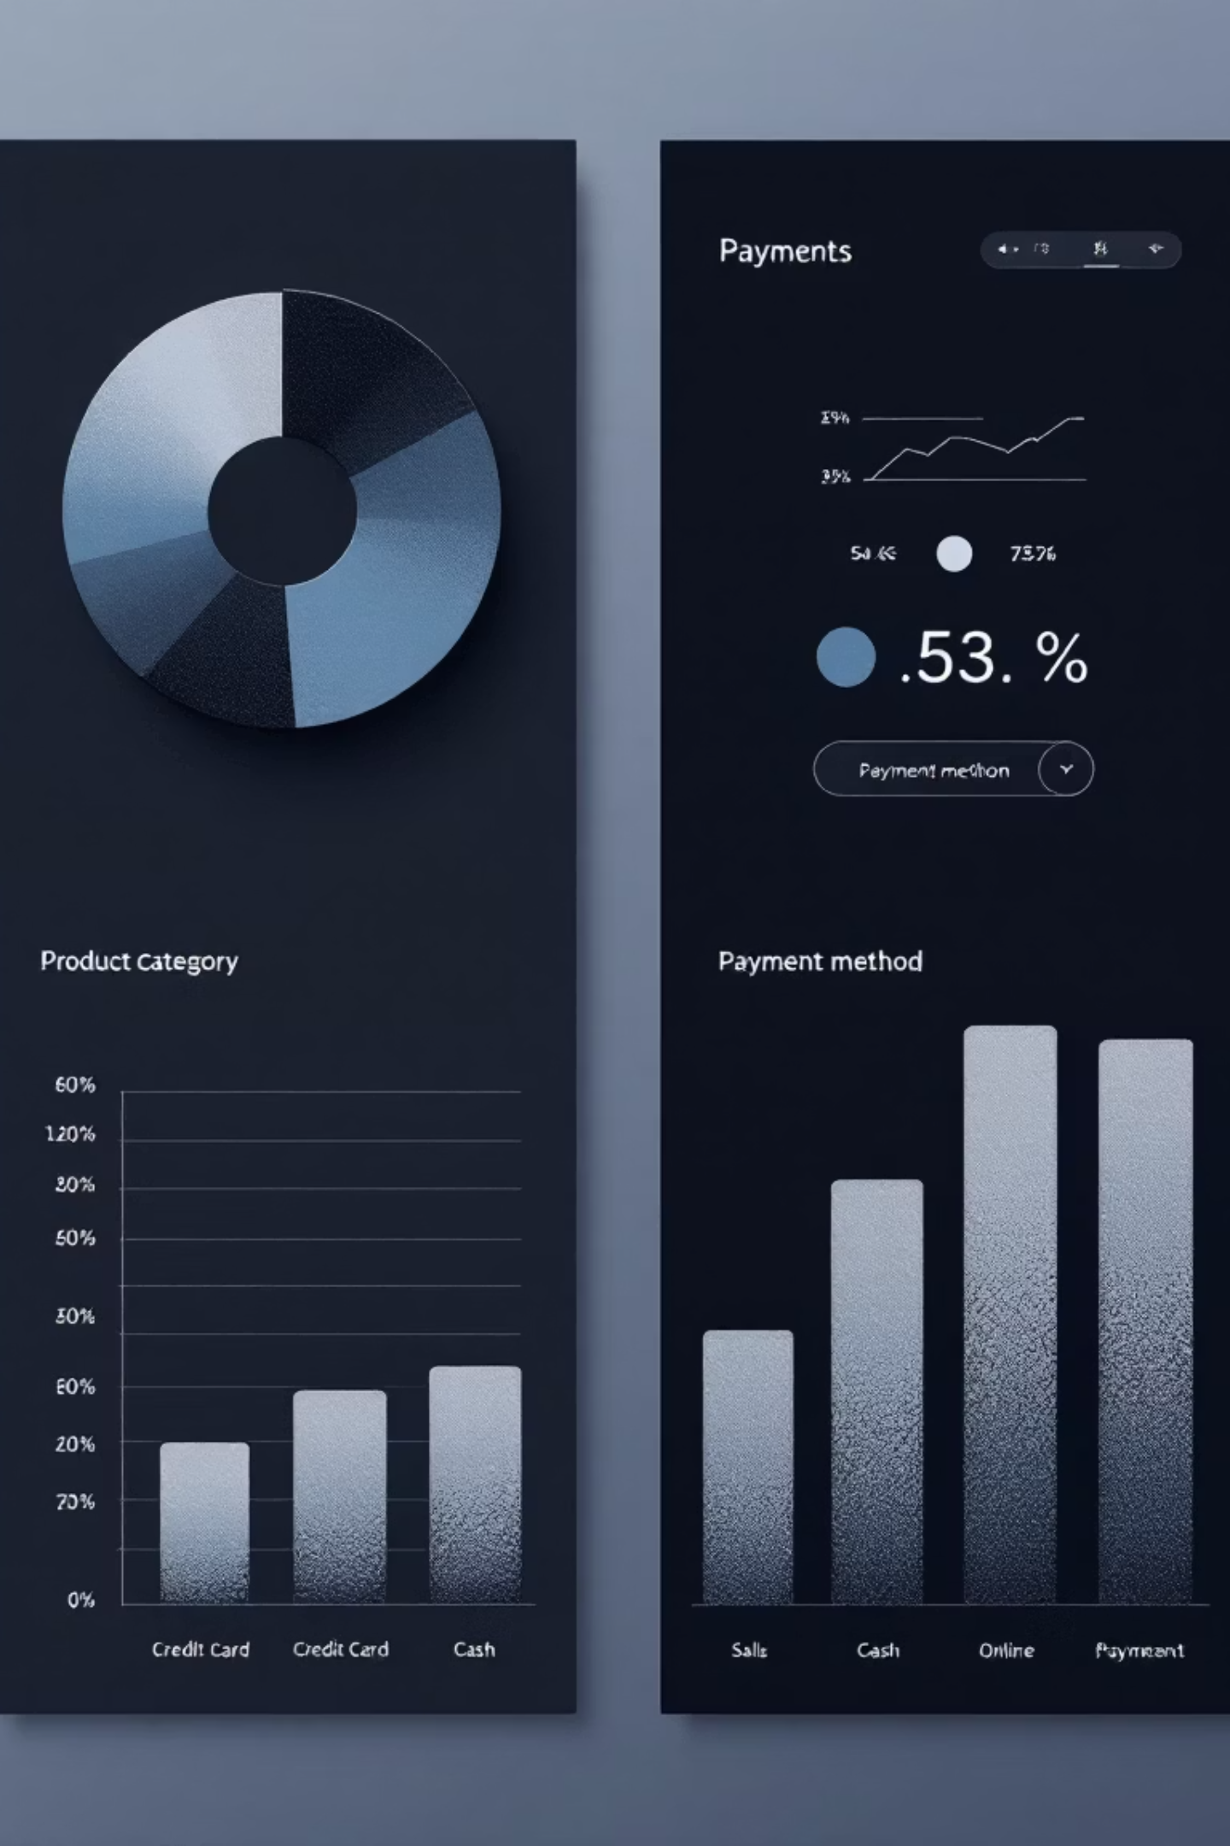
Chart Queries (1/2): Unpacking Sales Dimensions
Beyond high-level KPIs, detailed drill-downs are crucial for actionable insights. These queries provide the data necessary to visualize sales performance across various critical dimensions, identifying trends and outliers.
Sales by Product Category
Discount by Region
SELECT SUM(Sales_Amount), Product_CategoryGROUP BY Product_Category
SELECT SUM(Discount), RegionGROUP BY Region
Sales by Sales Channel
Sales by Payment Method
SELECT SUM(Sales_Amount), Sales_ChannelGROUP BY Sales_Channel
SELECT SUM(Sales_Amount), Payment_MethodGROUP BY Payment_Method

Slide 5








Chart Queries : Performance and Representative Analysis
These advanced queries allow us to dive deeper into product performance and individual sales representative effectiveness, providing granular data for optimizing sales strategies and resource allocation.
Quantity by Product Category
Products by Sales Rep
SELECT SUM(Quantity_Sold), Product_CategoryGROUP BY Product_Category
SELECT COUNT(Product_ID), Sales_RepGROUP BY Sales_Rep
Sales by Rep & Payment
Sales by Rep & Category
SELECT Sales_Rep, Payment_Method, SUM(Sales_Amount)GROUP BY Sales_Rep, Payment_Method
SELECT Sales_Rep, Product_Category, SUM(Unit_Price)GROUP BY Sales_Rep, Product_Category

Slide 6
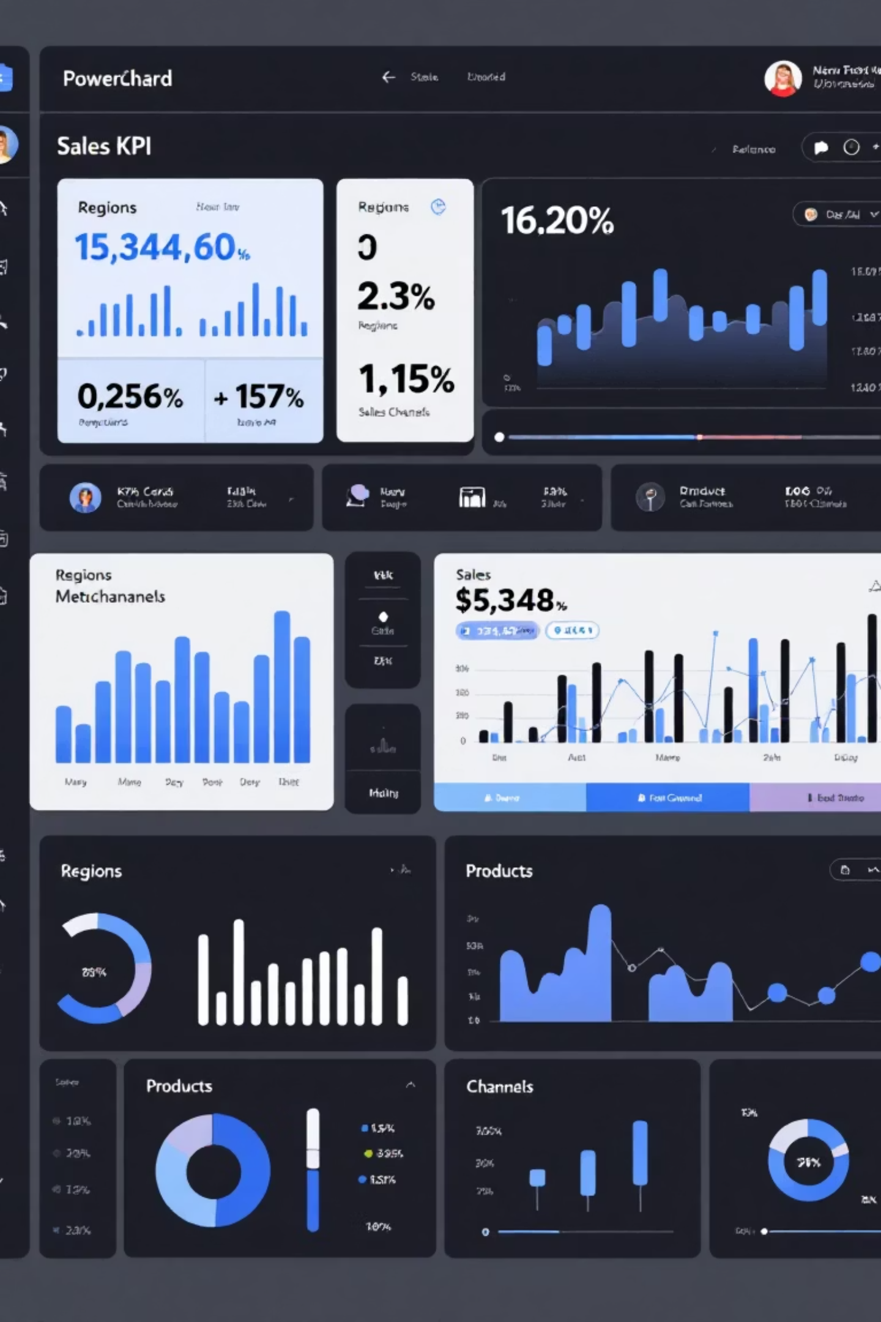
Dashboard Overview: Powering Business Decisions with Power BI
Our comprehensive Power BI dashboard brings all these SQL-driven insights to life, offering an interactive and visually intuitive platform for stakeholders. This centralized view allows for rapid identification of performance trends and areas for improvement.
KPI Cards: Immediate visibility into Total Sales Amount, Quantity Sold, Total Cost, and Total Price.
Sales Breakdowns: Detailed charts for Sales by Product Category & Sales Channel.
Regional and Discount Analysis: Insights into Sales by Region and the impact of Discounts.
Revenue by Payment Method: Understanding customer payment preferences.
Sales Rep Performance: Granular data on sales representative effectiveness across product categories and payment methods.

Slide 7
Key Learning Outcomes & Future Impact
This project provided invaluable experience in the complete data analytics lifecycle, from raw data to actionable business intelligence. The skills gained are directly transferable to enhancing decision-making across various business functions.
1
SQL Query Mastery
Proficiency in writing complex SQL queries for both KPI extraction and detailed chart data.
2
Data Modeling & Visualization
Expertise in data modeling within Power BI and creating compelling visual narratives.
3
Performance Tracking
Ability to define, track, and interpret key business performance indicators for strategic insights.
4
Interactive Dashboard Creation
Developing dynamic, user-friendly dashboards for management, enabling self-service analytics.
5
Data-Driven Decision Making
Fostering a culture of informed decisions based on comprehensive sales insights, leading to optimized strategies and improved business outcomes.

Slide 8
THANK YOU

